Slide 1
Team #1

Slide 2
Preprocessing Part 1
Mohamed Mossad

Slide 3
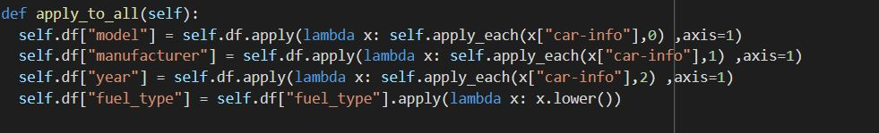
Convert Car_info Column
Car_info column contain list of 3 values
Add 3 new columns and add list values to each corresponding column
apply allow the users to pass a function and apply it on every single value of the Pandas series.
One can use apply() function in order to apply function to every row in given dataframe. Let’s see the ways we can do this task.

Slide 4
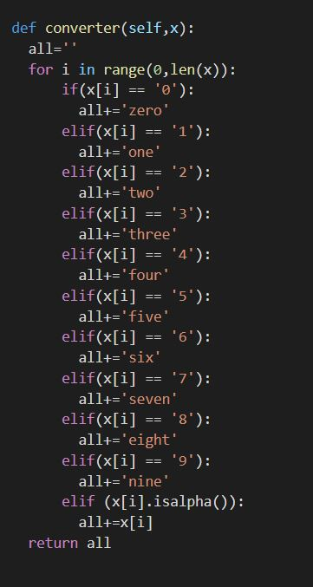
Converter
To convert numbers to string values to be able to use at get_dummies function
When using get dummies on column that have numerical values as string
eg . “200”
Get dummies try to assign a column with the the numerical value as label to the new column. When it try to label a column with numerical values it fails and drop the value.

Slide 5
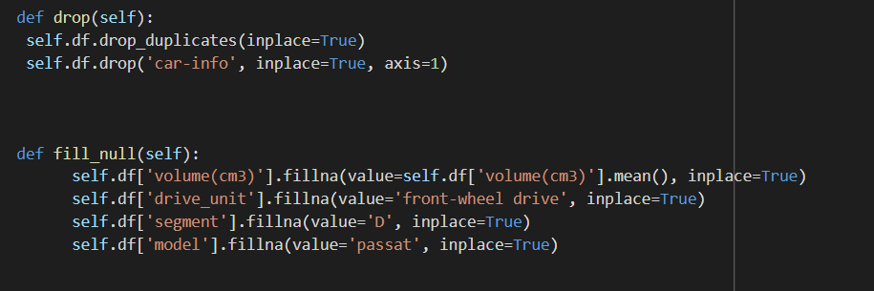
Fill Null
Drop duplicates
Drop Car_info Column
replace Null values in dataframe

Slide 6
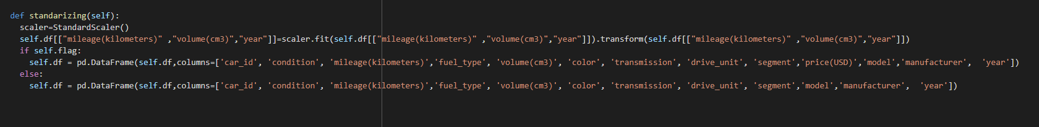
Standardize
Standardizing numerical columns with large values
Standardization is a very important concept in feature scaling which is an integral part of feature engineering. When you collect data for data analysis or machine learning, we will be having a lot of features, which are independent features. With the help of the independent features, we will try to predict the dependent feature in supervised learning.

Slide 7
Preprocessing Part 2
Shehab Ahmed

Slide 8
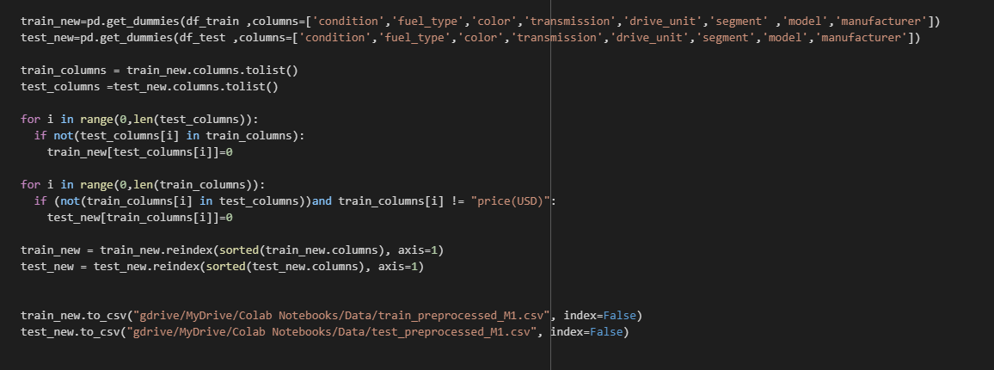
Use get dummies to convert Categorical Data to Numerical andd assign a new column to each one.
Train and test dataset have some values in model that are not in both dataset
When using get dummies on those unique values, each dataset will have some columns not in the other one
Add those unique columns to the other dataset and assign 0 to all values of this column
Reindex each dataset
Extract the dataframes into csv files

Slide 9
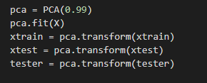
Features Selection
Use Dimension reduction technique PCA on training dataset (excluding output column) then fit the test dataset on it

Slide 10
SVM and Poisson models
Mohamed Adel

Slide 11
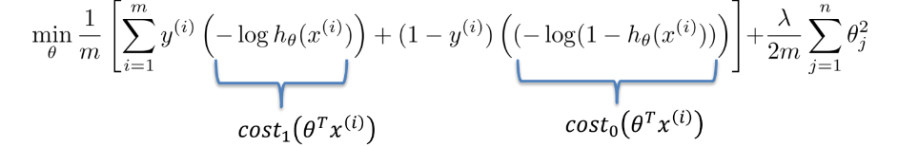
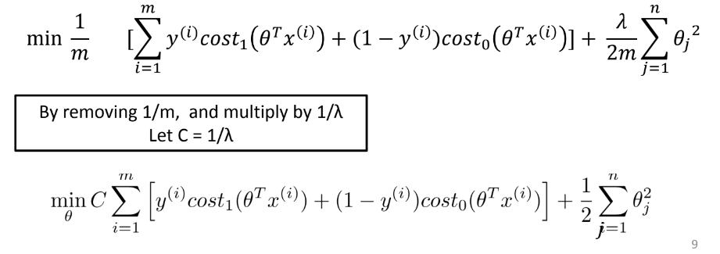
Support Vector Machine
Logistic regression:
Support vector machine:

Slide 12
Support Vector Machine cont..
Support vector machine properties:
• They are the training points that define the maximum margin of the
hyperplane to the data set
• They determine the shape (position & orientation) of the hyperplane. If
one of them is removed, the resulting hyperplane would change.
• They are the most difficult data to classify.

Slide 13
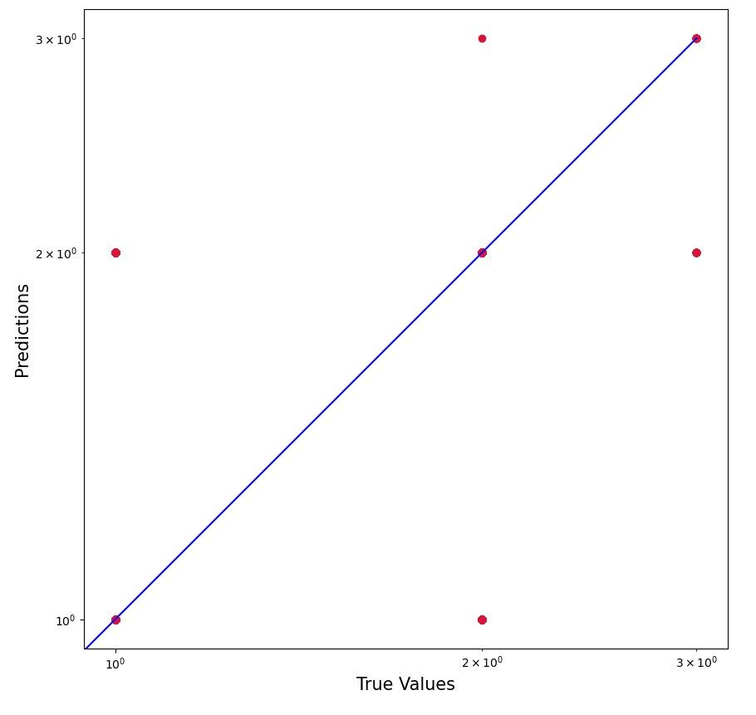
Support Vector Machine cont..
Accuracy = 89

Slide 14
Poisson regression
Poisson regression are commonly to model count data, which is discrete data that can only take non-negative integer values.
Poisson regression is a type of generalized linear model(GLM). a GLM includes three components:
A probability function, which is the poisson distribution in this example.
A linear predictor (n).
A link function, which transforms the mean of the response into a linear predictor.

Slide 15
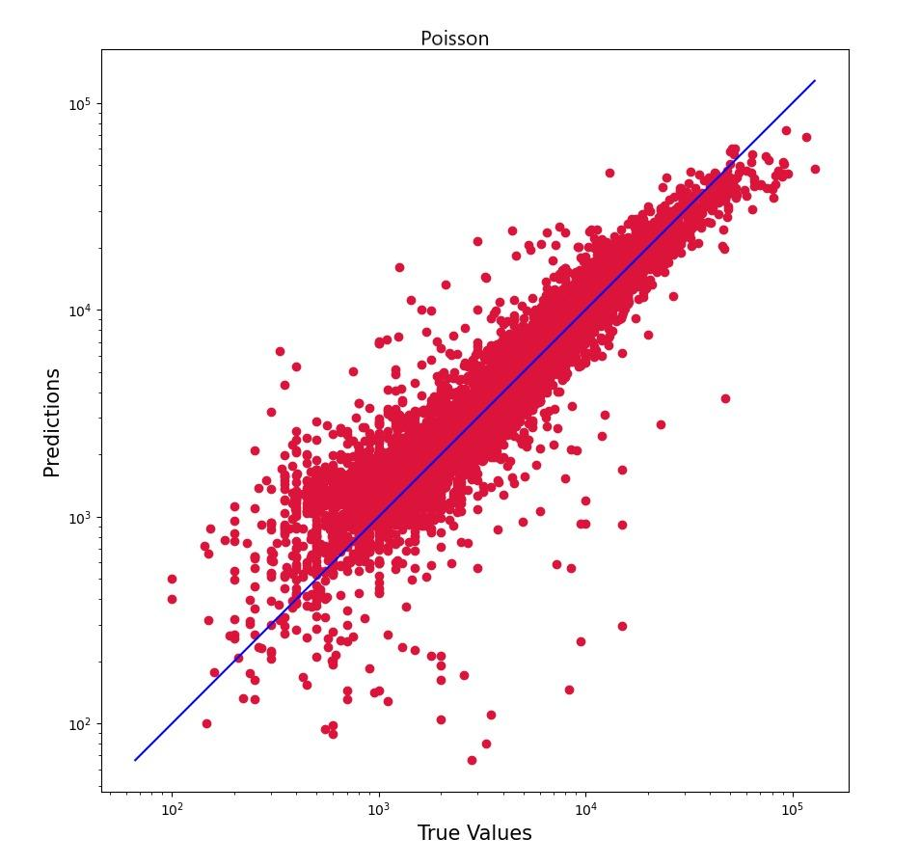
Poisson regression cont..
MSE(mean square error) = 3022

Slide 16

Random forest
—>Omar essam shendy

Slide 17
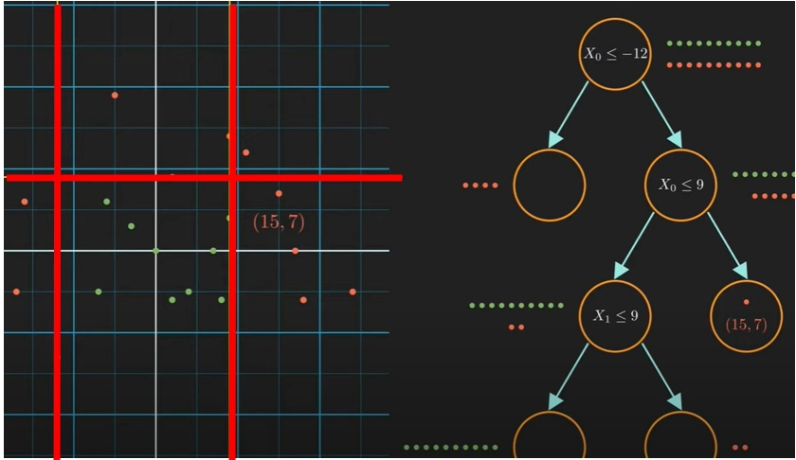
What is a decision tree?
splitting ”value” of a feature(Xi) defines classes.
(information theory)
entropy
Decision boundary
information gain
Decision nodes= condition to split the data
Leaf node: all data that reaches that node belong to the same class.

Slide 18

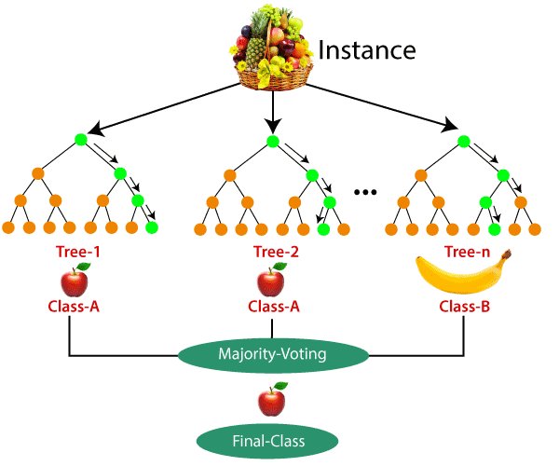
General idea
- > Is a collection of multiple RANDOM decision trees.
random?
1) subset datasets
2) For each data-subset a decision tree
3) majority vote
- >Much less sensitive to the training data ( NO high variance -> fail to generalize)

Slide 19

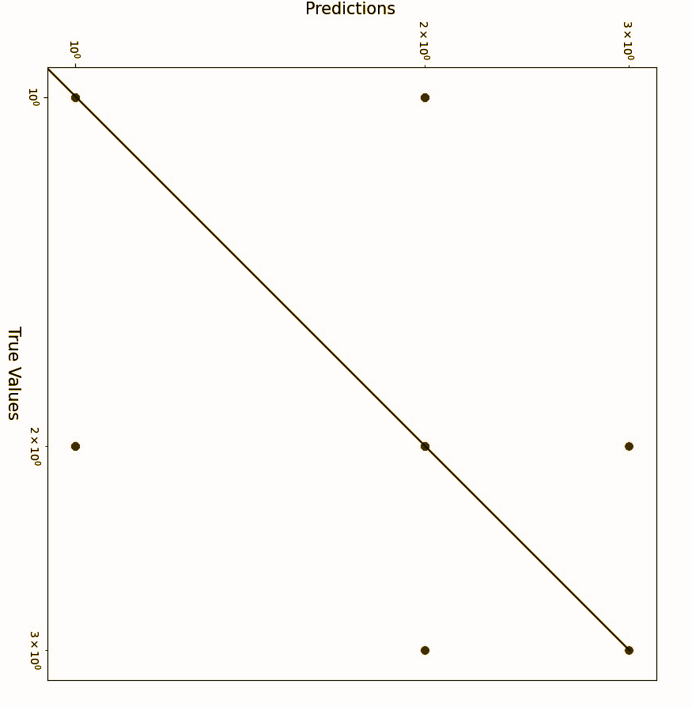
work
milestone2 classification
Accuracy = 88
max_leaf_nodes=20 ->60->400
accuracy = 0.5->0.8->0.87
After 100, accuracy minimal accuracy change
n_estimators = 100 ---> 500
accuracy = 0.881—-->0.882
Not much difference

Slide 20

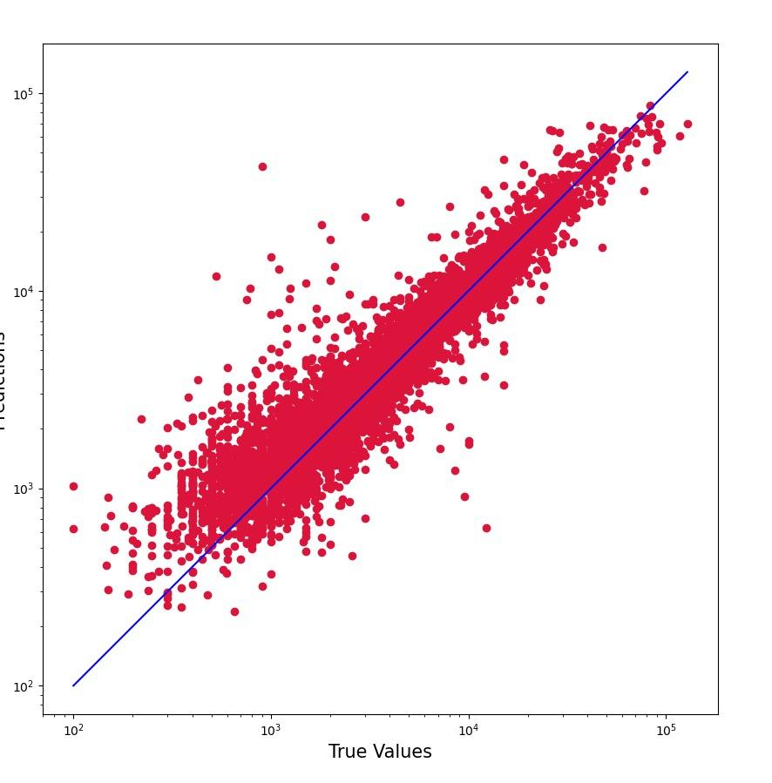
work
milestone1 regession
mse = 2653

Slide 21
The k-Nearest Neighbors (kNN)
Ibrahim Abd Elghany Mansor

Slide 22


Slide 23
How does it work?
K is the number of nearest neighbors to use. For classification, a majority vote is used to determined which class a new observation should fall into. Larger values of K are often more robust to outliers and produce more stable decision boundaries than very small values (K=3 would be better than K=1, which might produce undesirable

Slide 24
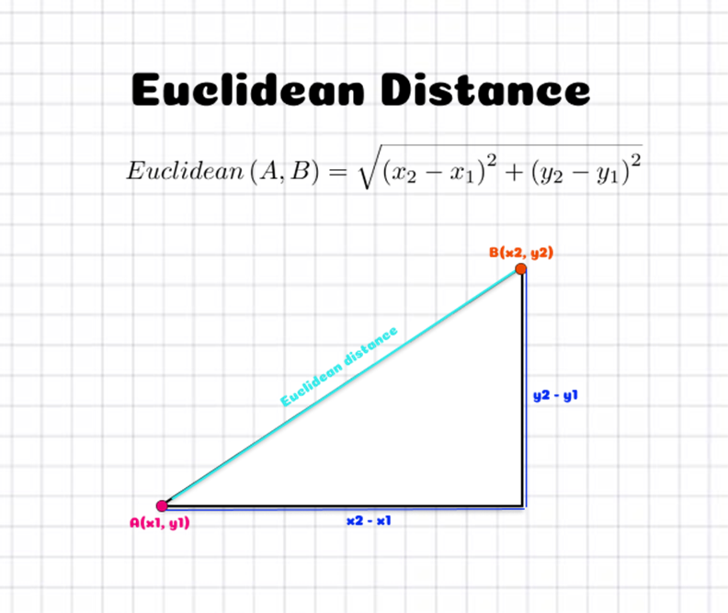

Slide 25
n_neighbors = 5 | algorithm = auto ------> accuracy = 0.8416909991113368
n_neighbors = 20 | algorithm = auto ------> accuracy = 0.8447378443569887
n_neighbors = 5 | algorithm = kd_tree ------> accuracy = 0.8416909991113368
n_neighbors = 5 | algorithm = brute ------> accuracy = 0.8416909991113368
ACURACY

Slide 26
model = KNeighborsClassifier( n_neighbors = 20)
model.fit(xtrain,ytrain)
pred=model.predict(xtest)

